Slide 1
PATHOPHYSIOLOGY OF SICKLE CELL DISEASE

Slide 2
Definition
Sickle cell anaemia is a haemoglobinopathy that results from a point mutation of the beta polypeptide chain of haemoglobin(Hb).
Haemoglobinopathy: disorders affecting the structure, fxn and prdn. of Hb. They are usually inherited.

Slide 3
BACKGROUND
Hb found in RBCs
A complex protein consisting of an Fe. containing heme group and protein chains
It’s a tetramer made of two pairs of PP. chains each having a heme group attached
Heme :protopophyrin 1X and Ferrous iron

Slide 4
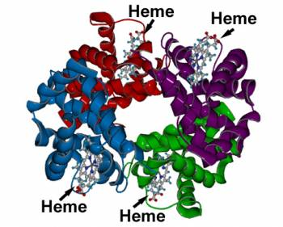

Slide 5
Development/types of Hb
Embryonic Hb:predominates wks.4-8, disappear by the 3rd month
Gower 1: ζ₂ ε₂
Gower 2: α₂ ε₂
Portland: ζ₂ γ₂
The zeta(ζ) chains are structurally similar to alpha chains

Slide 6
Fetal Hb
Contains α₂ γ₂
Predominates by the 10-11th wk, by 24th wk it constitutes 90%, declines in 3rd trimester :makes 70% of Hb at birth.Synthesis declines rapidly postnatally only traces found by 6-12 mo.
Adults have less than 2% fetal Hb
Its heterogeneous coz the γchain synthesis is directed by 2 sets of genes.Chains differ at position 136 in presence of either glycine or alanine.ratio at birth 3:1

Slide 7
Adult Hb
Hb A₁: α₂ β₂
Hb A₂: α₂ δ₂
Hb A₁ makes 5-10% of the total by wk 24. At term 30%, by 6-12 mo. The adult pattern appears.
Hb A₂ makes 2-3%
Ratio of A₁:A₂=30:1
Alpa chains 141 AA, beta 146AA

Slide 8
Alterations of Hb by disease
Gower found in trisomy 13/15
Portland found in stillborn infants with homozygous α thalassemia
Hb F elevation occurs with haematologic stress
HbA₂ elevated in beta thal., vit.B₁₂ def. and folate def. Decreased levels in Fe. Def. and alpha thal.

Slide 9
Genetics
Alpha like chains encoded by two sets of genes on Ch.16
Beta,gamma and delta chains encoded by genes on Ch. 11

Slide 10
Classification of hemoglobinopathies
Structural ;mutation of amino acids of globin chain leading to abn.polymerization,altered solubility and O2 binding
Thalassemia syndromes:impaired prdn. of globin chains
Thalassemia hemoglobin variants: combine features of thal. and structural Hbpathies

Slide 11
Cotd
Hereditary persistence of fetal Hb(HPFH)
Acquired Hbpathies: modification of Hb molecule by toxins eg.methemoglobinaemia

Slide 12
Epidemiology
The disease is common in Africa, Middle east, Mediterranean countries and in India.
In the US the disease is common among the blacks with 8% of them being carriers and 0.8% being homozygous
In Kenya SCD is common among the Luo(53.4%) and Luhyia(24.2%) tribes in western Kenya and among the Miji Kenda(18.7%) at the coast.

Slide 13
Cotd
Other tribes including the Kisii’s and the Kamba’s have been found to have the disease
The sickle cell trait however has been found in nearly all the tribes of Kenya with the Miji Kenda leading at 35%
There are no significant differences between the males and females
Majority of the cases are between 1-20 years of age
2003:26% of Kenyans in malaria holoendemic regions had the sickle cell genotype opposed to only 3% in the highland regions

Slide 14


Slide 15
Haplotypes
Senegal –found commonly along the Atlantic coast of W. Africa
Benin-Found in Central, West Africa, Angola and Kenya
Bantu/Central Africa Republic-common in Zaire,CAR,Kenya
Asia-Common in Saudi Arabia and India

Slide 16
Sickle cell Disease
Major forms:
Homozygous SS-most common, worse
clinical presentation
Sickle-beta thalassemia-β⁰ and β⁺
Hb SC
Rare forms
Sickle cell Hb D _{punjab} dse
Sickle cell Hb O_{Arab}dse

Slide 17
History
1st described by Herrick in 1910
Syndenstericker described the first paediatrics case.He recognized that it’s a hemolytic dse.
1949-Pauling identified it as an autosomal disorder
1959-Ingram described the substitution of valine for glutamate
Was the 1st dse to be described to be due to molecular mutation

Slide 18
Pathophysiology
Basic defect:Replacement of glutamate by valine at position 6 of the beta globin chain
The clinical presentation is due to either of these main pathophysiologic processes
vaso-occlusion
hemolysis
Infections

Slide 19
Molecular pathogenesis
The presence of valine at position 6 creates a hydrophobic chain that also has a high propensity of binding with other globin chains
This leads to interaction btwn. different Hb molecules leading to aggregation into large polymers.
The polymerization is the 1º event that leads to distortion of shape and decreased deformability of the cells

Slide 20
Cotd.
The formation of a single nucleus of aggregated molecules is followed by growth and alignment of fibers
Distortion of shape follows leading to disturbance of structure and function of the membranes

Slide 21
Rate /Extent of polymer formation depends on:
Degree and rate of deoxygenation
Hb conc.
Intracellular Hb type.
pH
Temperature
Extacellular osmolarity

Slide 22
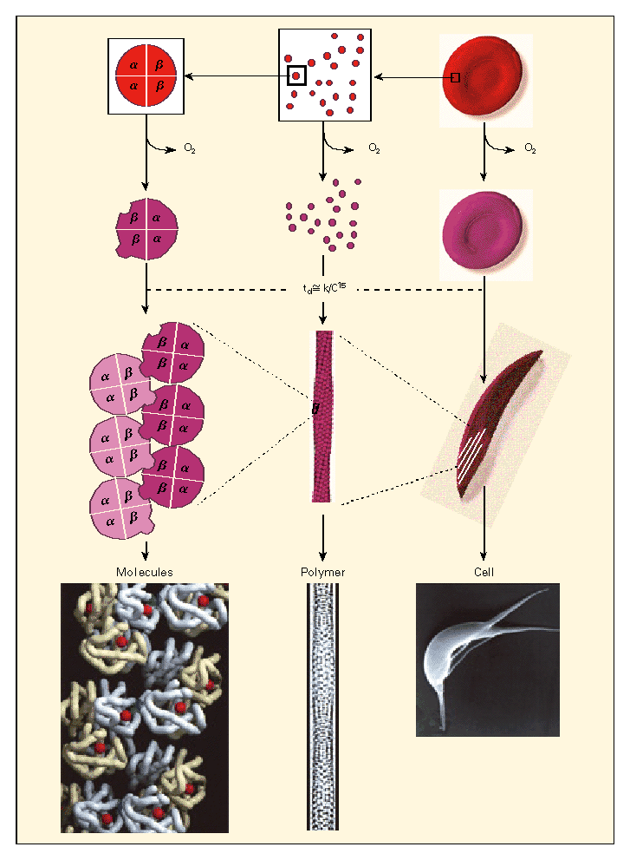

Slide 23
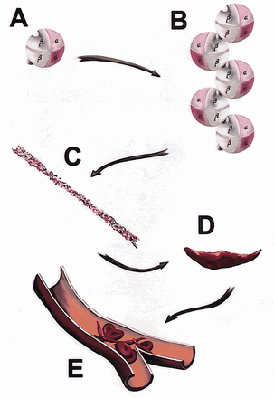


Slide 24
Kinetics of HbS polymerization
Rapid deoxygenation leads to formation of multiple independent polymers.This leads to granular or cobblestone texture that does not alter the cell shape
Partial or slow deoxygenation leads to formation of a single nucleus.This is followed by growth and alignment of more fibers.

Slide 25
Dysregulation of red cell volume
Mean intracellular Hb.conc.and mean density of SS RBCs is close to that of normal RBC.However the density distribution is broad.Less dense cells are due to reticulocytosis with low Hb conc. Very dense cells are due to polymerization induced membrane damage leading to enhanced dehydration.This usually leads to irreversibly sickled cells.

Slide 26
Dehydration
Main factors that lead to dehydration: K^{+,}Cl¯ co transport and Ca⁺⁺ activated K efflux (Gardos channels)
In normal RBCs the K⁺,Cl– co transporter is found only in reticulocytes
Rates of co transport in SS and CC RBCs high

Slide 27
Cotd
The co transport is induced by cell swelling and low pH (may occur with stagnant circulation)
This co transport system is inhibited by magnesium
SS RBCs have increased Ca⁺⁺ in intracellular vesicles but its normal in cytosol.

Slide 28
Cotd.
Membrane destruction leads to transient increase in cytosolic calcium .This opens the Gardos channels leading to loss of water and K⁺
The Gardos channels are inhibited by clotrimazole

Slide 29
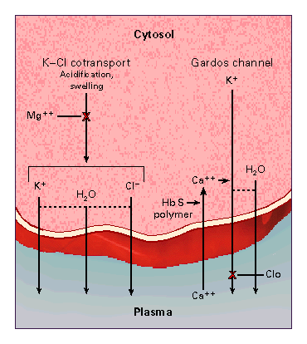

Slide 30
Interaction of SS cells and vascular endothelium
Most challenging aspect in SCD is the unpredictable and episodic nature of vasoocclusion
Potential for a sickled cell to initiate a vaso-occlusive event depends primarily on whether the rate of polymer formation is within the range of capillary transit time

Slide 31
Cotd
Its been shown that SS red cells have a sticky surface and attach more readily than normal cells to endothelium
Degree of adherence strongly correlated to severity of disease

Slide 32
Molecular interaction for adhesion
Reticulocytes esp. those of pts. With SCD have on their surface the integrin complex α4β1 which binds to fibronectin and VCAM-1
VCAM-1 usually expressed by endothelial cells after activation by inflammatory cytokines eg TNFα.

Slide 33
Cotd.
Microvascular endothelial cells and sickle erythrocytes have CD36which binds to thrombospondin secreted by activated platelets
Thrombospondin also binds to sulfated glycans on SS cells
Other molecules that contribute to the adhesion include the very high molecular weight form of von willebrand factor
Increased binding of SS reticulocytes to fibronectin also contributes

Slide 34
Cotd.
VCAM is upregulated by hypoxia and inhibited by nitrous oxide
Low nitrous oxide levels also promote adhesiveness

Slide 35
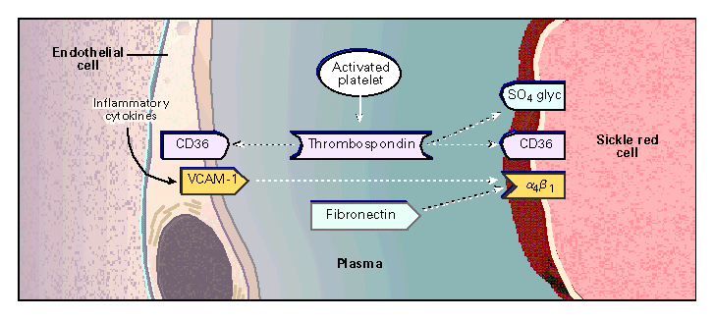

Slide 36
Other factors
Adherent SS RBCs are known to inhibit vasorelaxation
Macrocirculation of pts. With SCA dvp. Intimal hyperplasia
With repeated episodes of polymerization heme is released from Hb .The Fe. In heme promotes formation of reactive oxygen species which damage the lipids and proteins of the RBCs membrane.
The damaged proteins form abn.clusters which lead to dvp of Ab.leading to hemolysis.

Slide 37
Cotd.
The membrane outer leaflet has increased amounts of phosphatidylethanolamine and phosphatidylserine which promote thrombosis

Slide 38
Haemolysis
One third of the haemolysis occurs intravascularly
This occurs due to membrane damage and fragmentation in the microvasculature
The SS RBCs also adhere to macrophages and undergo phagocytosis
Rest of haemolysis occurs in the spleen and in the liver

Slide 39
Acute chest syndrome
Infections
Fat embolism
Pulmonary thromboembolism
Vaso occlusion

Slide 40
Reduced immunity
Asplenia
Reduced IgM
Impaired opsonization
Sluggish alternate complement pathway

Slide 41
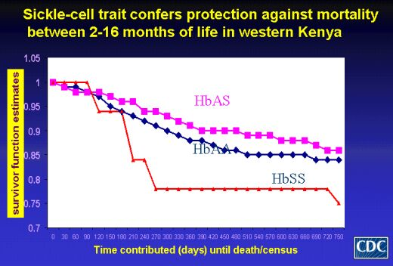

Slide 42
Aplastic crises
Infections
Folate deficiency
Toxins

Slide 43
Sickle cell nephropathy
Renal haemodynamics usually normal upto thirty years of age
Inability to conc. Urine the commonest disorder
In sicklers usually there’s increased renal plasma flow .This is accompanied by increased GFR.

Slide 44
Cotd. Nephropathy
The increased GFR leads to glomeruloscrerosis and you may get proteinuria
The vasa recta pass thro. A hypertonic interstitium which promotes sickling and vascular obstruction.
The obstruction interferes with the countercurrent mechanism leading to decreased ability to conc. urine

Slide 45
Pulmonary hypertension
One out of every three adults with SCD develop pulmonary hypertension
This is related to low levels of NO
Low NO has been attributed to decreased levels of AA arginine
During haemolysis the enzyme arginase which is normally in high amounts in the RBCs is released destroying the arginine
Free Hb is also a scavenger of NO

